Slide 1

PROCESS MINING VIRTUAL INTERNSHIP
by
MOIN ALI KHAN T
Roll No. 224G1A3357
Department of Computer Science and Engineering (AI&ML)
Srinivasa Ramanujan Institute of Technology
(Affiliated to JNTUA & Approved by AICTE) (Accredited by NAAC with ‘A’ Grade & Accredited by NBA (EEE, ECE & CSE)
Rotarypuram Village, B K Samudram Mandal, Ananthapuramu – 515701.
2024 - 2025

Slide 2

Contents
Course Objective
Introduction
Technology
Applications
Modules
Real Time applications
Learning outcomes
GitHub Link
Queries

Slide 3
Course Objective
Participants will gain a comprehensive understanding of process mining's variance applications across industries.
Understanding the fundamental concepts and principles of process mining.
Learning how to apply process mining techniques to real-world datasets.
Gaining knowledge in using process mining tools and software.
Acquiring knowledge of advanced process mining techniques, such as predictive analytics and decision mining.

Slide 4
Introduction
I did Process Mining Virtual internship from May 2023 to July 2023,through EduSkills-AICTE virtual internship oppurtunity.
The process mining was done in the platform of Celonis website, it helps companies achieve process excellence through its platform by eliminating operational friction with their Intelligent Business Cloud .
Process Mining is a widely-used technology to model, ananlyze, and optimize business process.

Slide 5
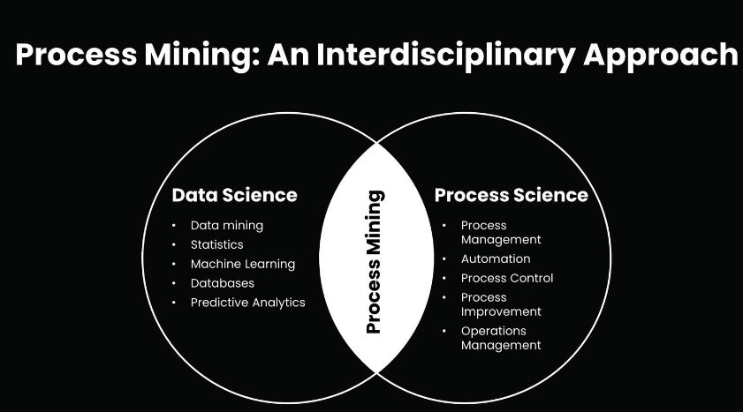
Intro....
The main use of this process mining technique is to find deviations and weak points in business processes.
Process Mining is combination of two disciplines: Data science and Business process Management.

Slide 6
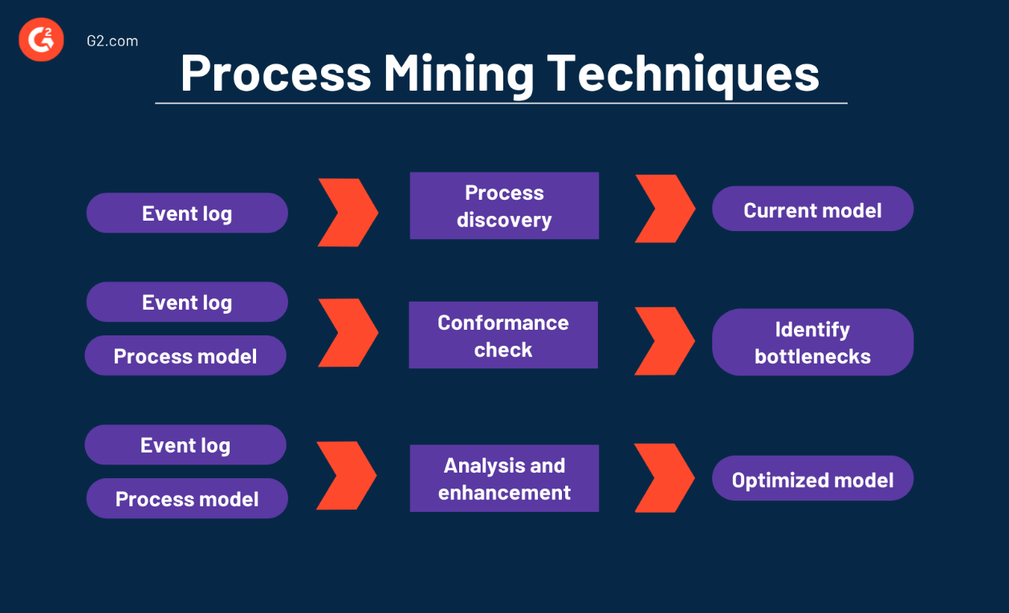
Technology
Process mining technologies encompass a range of tools and techniques that enable the analysis and optimization of business processes.

Slide 7
Contd....
Some popular process mining technologies include:
Process Discovery: These technologies automatically extract process models from event logs, allowing for the visualization and understanding of the actual process flow.
Conformance Checking: These technologies compare the discovered process model with the expected or desired process model, identifying deviations and highlighting areas for improvement.
Performance Analysis: These technologies analyze process execution data to identify bottlenecks, inefficiencies, and opportunities for optimization. They provide insights into process cycle times, resource utilization, and other performance metrics.

Slide 8
Applications
Performance Monitoring:
Process mining helps the company see how well they're doing. It looks at things like how fast tasks are getting done, if there are any problems slowing things down, or if people are doing things the right way.
Predictive Analytics:
Advanced process mining techniques can be used to predict future process behaviors based on historical event data. This can be useful for forecasting demand, anticipating process bottlenecks, and making proactive decisions.

Slide 9
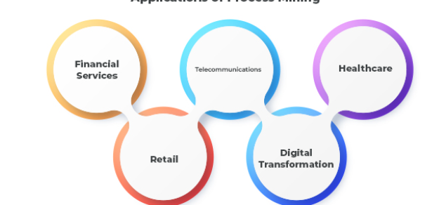
Contd....
Customer Journey Analysis:
Process mining can provide insights into the customer journey by analyzing interactions and touchpoints across different departments and systems. This helps organizations enhance customer experiences and identify pain points.

Slide 10
Modules
Data Extraction and Collection:
• In this initial phase, relevant data is extracted from various sources, such as ERP systems, databases, and application logs.
The data collected usually includes timestamps, activity names, case IDs, and other relevant attributes that capture the process execution.
Predictive Analysis:
• Some advanced process mining tools incorporate machine learning techniques to predict future process behaviors based on historical data.
• Predictive analytics can be used to forecast potential bottlenecks or delays and make proactive adjustments.

Slide 11
Contd....
Data Preprocessing:
Raw data often requires cleaning and preprocessing to ensure accuracy and consistency.
Data preprocessing involves tasks like handling missing values, removing duplicates, and transforming data into a suitable format for analysis.

Slide 12
Real-Time Applications
Healthcare Process Monitoring:
In healthcare, process mining can be used to track patient flows, resource utilization, and treatment timelines in real time to enhance patient care.
Risk Management in Banking:
Financial institutions can use process mining to monitor real-time data related to financial transactions and identify potential risks or regulatory non-compliance.

Slide 13
Contd.....
Manufacturing Process Control:
Real-time process mining can monitor manufacturing processes, identifying deviations and ensuring that production lines are running efficiently.
Supply Chain Optimization:
Real-time process mining can help optimize supply chain operations by tracking the movement of goods, identifying delays, and ensuring timely deliveries.

Slide 14
Learning outcomes
Process mining is and its importance in analyzing and improving processes.
Explore various real-world applications of process mining across industries and sectors.
Familiarize yourself with basic process mining software and their functionalities.
process mining to discover and visualize actual processes from event logs.

Slide 15
Git Hub Dashboard

Slide 16
Any Queries?

Slide 17
Thank You!!!

